Slide 1
Generative AI: The Precursor of Agentic AI
mirjam nilsson

Slide 2
What is Generative AI?
Generative AI, refers to a category of artificial intelligence models that are capable of generating new (novel) and original content.
This content can take various forms, such as images, text, code, or even entire datasets.
Generative AI systems have the capability to produce content that was not explicitly programmed or provided in the training data.

Slide 3
Generative AI is a Deep Learning Technology
Generative AI is strongly based on deep learning models and word embedding technologies
As we are going to see, deep learning models succeeded in capturing the hidden rules for generating or understanding language with surprising details
While human beings focus on upper grammar, syntax, lexical and semantic rules, deep learning models discover and capture micro-level grammar, syntax and semantic rules well-welded in low level math structures
The capabilities of deep learning models have been greatly boosted by word embedding technologies that made it possible to learn low level contexts of words and sentences

Slide 4
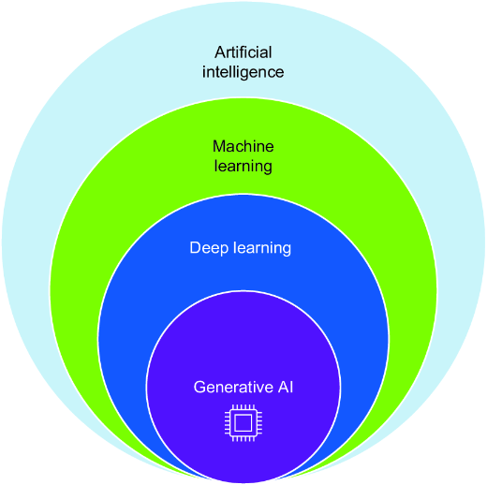
Generative AI is a subset of Deep Learning

Slide 5
Main Goal
The primary goal of generative models is to understand and learn patterns from existing data so well that they can generate similar, but new, data points.

Slide 6
Large Language Models: LLM’s
In the early days of AI, deep learning models were able to handle only small datasets due to limitations of hardware and the lack of data
In the Big Data era deep learning models are now able to handle huge datasets, which led to what we call Large Language Models (LLM’s)

Slide 7
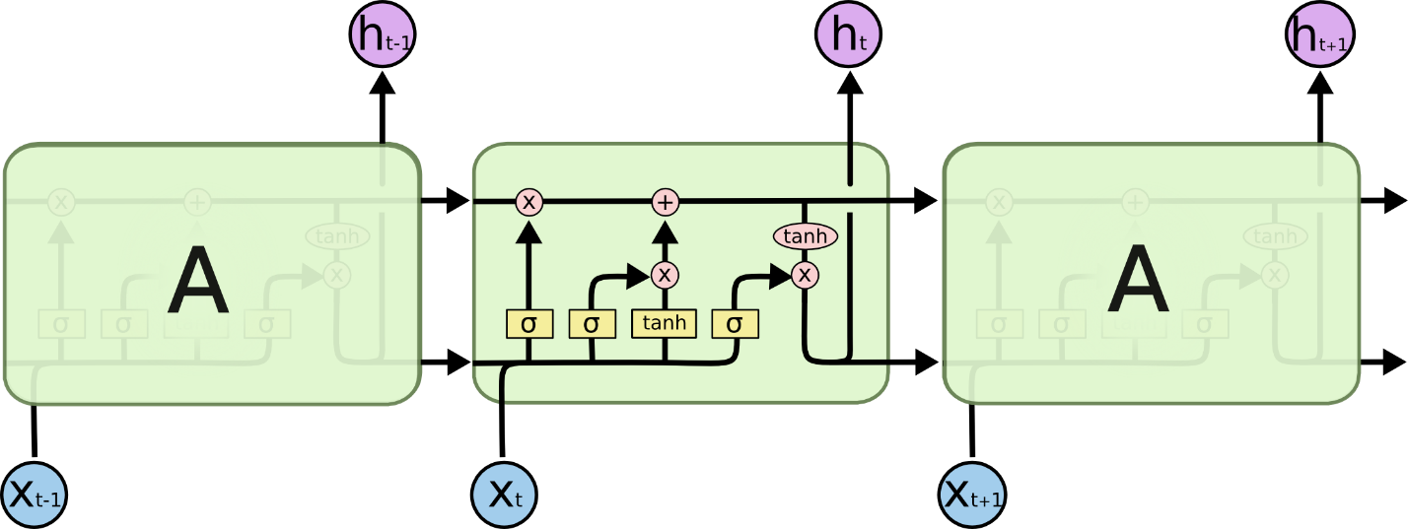
Sequential LSTM Models
Recurrent Neural Networks (RNNs) and Long Short-Term Memory (LSTM): These are types of neural networks that can be used for sequence generation tasks, such as generating sentences, paragraphs, or even entire articles.

Slide 8
Generative Adversarial Models
Generative Adversarial Networks (GANs): GANs consist of two neural networks, a generator, and a discriminator, which are trained simultaneously through adversarial training.
The generator creates data, and the discriminator evaluates how closely it resembles real data.
The two networks improve iteratively, with the generator aiming to generate realistic content and the discriminator becoming better at distinguishing between real and generated data

Slide 9
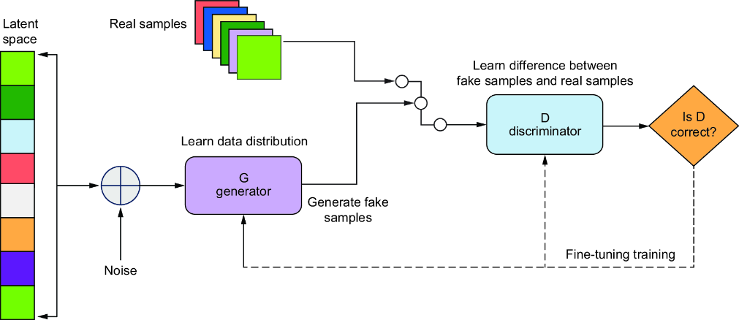
GAN

Slide 10
Variational Autoencoders (VAEs)
Variational Autoencoders (VAEs): VAEs are a type of generative model that learns a probabilistic mapping between input data and latent space.
This latent space is then used to generate new data points that share similar characteristics with the training data

Slide 11
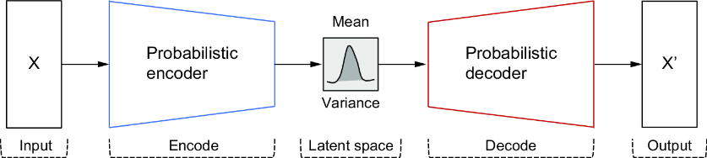
VAE’s

Slide 12
GPT’s
GPT, short for "Generative Pre-trained Transformer," is a family of natural language processing models developed by OpenAI.
GPT models are designed to understand and generate human-like text, making them versatile for various language-related tasks, including text generation, translation, summarization, question-answering, and more.
These models are built on the Transformer architecture, which has become a cornerstone in modern NLP.

Slide 13
What is ChatGPT
ChatGPT, is a model developed by OpenAI, is an advanced AI conversational agent. It is an instance of the GPT-4 model, which is a part of the Generative Pretrained Transformer series.
At its core, ChatGPT uses machine learning techniques to generate human-like text based on the input it receives. It can understand the context of a conversation, answer questions, provide explanations, and even generate creative content, such as stories or poems.
The "GPT" in ChatGPT stands for "Generative Pretrained Transformer," which represents the foundational technology that powers it:
Generative signifies the model's capability to generate text rather than just understanding or classifying it.
Pretrained indicates that the model has undergone an initial training phase where it learned from a large corpus of Internet text.
Transformer refers to the type of model architecture used, which helps understand the context of the input text.
This combination of technologies enables ChatGPT to generate meaningful responses which closely mimic natural human conversation.

Slide 14
Transformer Models
Transformer Models: Transformer models, like GPT (Generative Pre-trained Transformer), have gained popularity for their ability to generate coherent and contextually relevant text. GPT, for instance, is pre-trained on vast amounts of text data and can then be fine-tuned for specific generative tasks

Slide 15
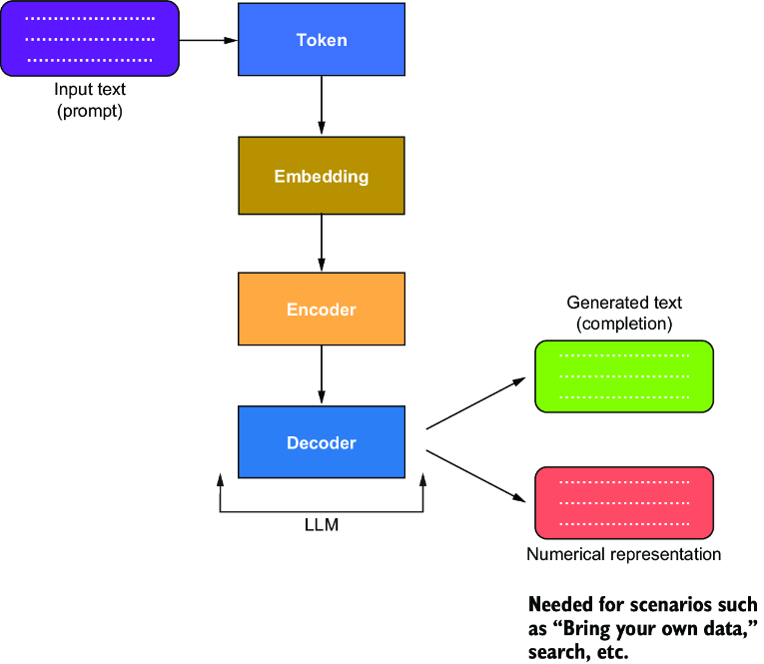
The Transformer

Slide 16
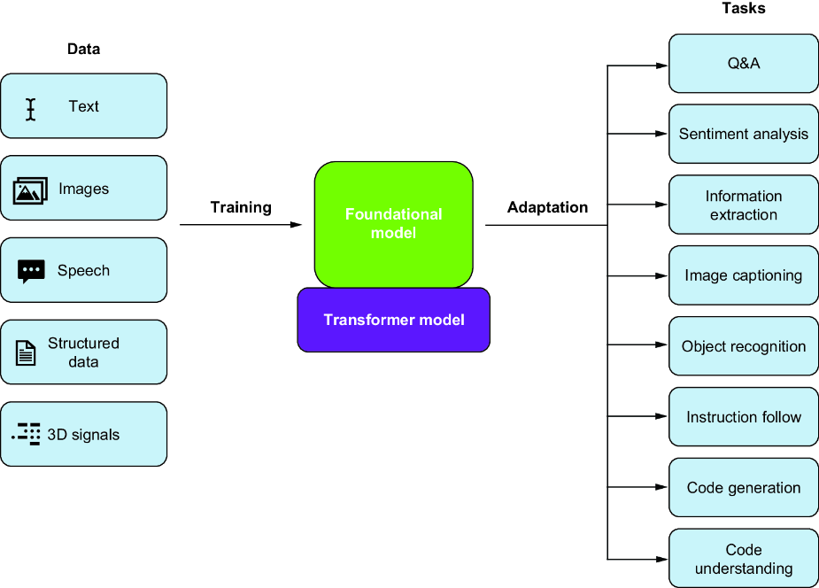
LLM and the Transformer

Slide 17
The Importance and Relevance of ChatGPT
For many years humans have been trying to interact with computer s using natural language instead of programing languages.
The dreams include writing applications, asking computers to build products, consultations, answering questions, solving problems, generating content.
ChatGPT is a dream-came-true
Although released only recently, Its ability to understand and generate human-like text is surprising and has a seemingly endless range of applications.
It’s a valuable tool in areas such as customer service and communication, content generation, education, research, language learning, data science, and many more.

Slide 18
ChatGPT Pretraining
ChatGPT is a Large Language Model (LLM) built upon a transformer architecture and is trained using a variant of unsupervised learning known as self-supervised learning.
This approach is a bit different from traditional unsupervised learning methods, but it's often categorized under the same umbrella due to its lack of reliance on labeled data.

Slide 19
Self-Supervised Learning
Concept: Self-supervised learning is a type of training where the model generates its own labels from the input data. For language models like ChatGPT, this typically involves predicting parts of the text given other parts.
Data Processing: The model is fed with large amounts of text data.
This data can include books, articles, websites, and other written material.
The text is tokenized (converted into a sequence of tokens, such as words or subwords) before being fed into the model.

Slide 20
Training Algorithm - Next Word Prediction
Masked Language Modeling (MLM): In models like BERT, some tokens in a sequence are randomly masked, and the model is trained to predict these masked tokens based only on their context.
Autoregressive Modeling: In models like GPT (which includes ChatGPT), the training involves predicting the next word in a sequence given the previous words. This is an autoregressive process, as the prediction for each word depends on the words that came before it.

Slide 21
Pretraining and Fine-Tuning
Pre-training: GPT models are initially pre-trained on massive text corpora from the internet. During this phase, the model learns to predict the next word in a sentence given the preceding context. It builds a strong understanding of grammar, vocabulary, and world knowledge.
Transformer Architecture: GPT models use the Transformer architecture, which relies on self-attention mechanisms to capture contextual information from input sequences effectively. This allows the model to handle long-range dependencies and understand the context of a word or phrase within a sentence.
Fine-tuning: After pre-training, GPT models can be fine-tuned on specific tasks or datasets. For example, they can be fine-tuned for language translation by providing pairs of sentences in different languages. Fine-tuning helps adapt the model's general language understanding to more specific tasks.

Slide 22
Interacting With ChatGPT: Prompts
A "prompt" in the context of ChatGPT or other GPT models is the input text that you provide to the model.
This input text guides the model's response.
The design of these prompts is crucial because the model's output heavily depends on the quality and structure of the input it receives.
Prompts can range from simple questions to complex instructions, and the model generates responses based on its training on a vast corpus of text data.
The effectiveness of a prompt often determines how relevant, accurate, or creative the model's output will be.

Slide 23
The Art and Science of Prompt Engineering
Prompt engineering is the skillful crafting of input prompts to elicit the desired response from a language model.
It's a blend of art and science, requiring an understanding of the model's capabilities and limitations, as well as creativity in phrasing prompts.

Slide 24
Example prompts and applications
Direct Question:
Prompt: "What is the capital of Finland?"
Instruction-Based:
Prompt: "Write a summary of the novel '1984' by George Orwell."
Creative Generation:
Prompt: "Compose a poem about the ocean in the style of Shakespeare."

Slide 25
Example Prompts and Applications?
Problem Solving:
Prompt: "How can I fix a leaking faucet?"
Contextual Conversation:
Prompt: "I'm feeling stressed about course load this semester. Do you have any advice?"
Coding Help:
Prompt: "Write a Python function to calculate the factorial of a number."

Slide 26
Tuning
Supervised Fine-Tuning:
Process: This involves training the model on a dataset of human-generated responses. The dataset typically consists of prompts and the corresponding ideal responses.
Effectiveness: Highly effective for improving response quality in specific domains or use cases. It helps the model learn context-specific nuances.
Reinforcement Learning from Human Feedback (RLHF):
Process:
Reward Modeling: Human trainers rank responses or provide scores to teach the model what constitutes a good response.
Proximal Policy Optimization (PPO): The model is updated to generate responses that are more likely to receive high scores.
Effectiveness: Very effective for aligning the model's responses with human values and preferences. It enhances the model's ability to generate safe, relevant, and contextually appropriate responses.
Prompt Engineering and Few-Shot Learning:
Process: Instead of fine-tuning the model, the input (prompt) is engineered to guide the model's response. Few-shot learning involves providing examples in the prompt to demonstrate the desired response format or content.
Effectiveness: This is more of a usage technique than a tuning method. It can be highly effective when specific fine-tuning is not feasible. The effectiveness depends on the skill in crafting prompts.

Slide 27
Domain Tuning
Domain-Specific Tuning:
Process: The model is fine-tuned on a specific domain or subject matter, such as legal texts, medical information, or technical documentation.
Effectiveness: Highly effective for improving accuracy in specialized areas. However, it requires a carefully curated dataset from the specific domain.
Hyperparameter Tuning:
Process: Adjusting the model's hyperparameters (such as learning rate, batch size, number of layers) to optimize performance.
Effectiveness: Can be effective for improving model training efficiency and stability, but requires deep expertise and experimentation.

